Slide 1
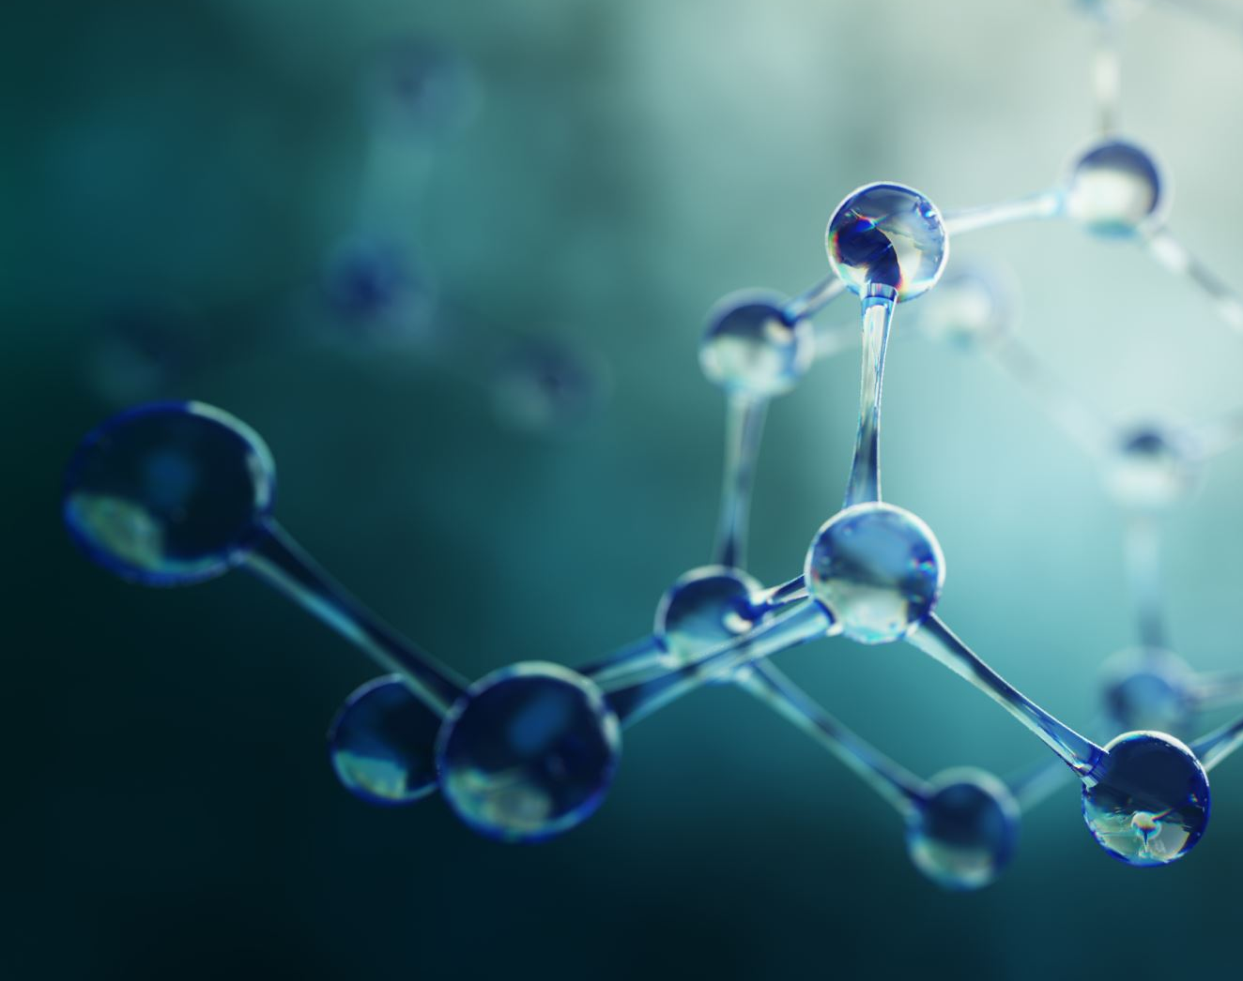
Dog Breed Identification
By: Rahul Awale, Rajendra Naidu Mannam, Sandeep Joshi, Jiawen Wei, Li Wang, Zengxin Qin

Slide 2
Introduction
Using Photographs of Dogs
APPLY Machine Learning Techniques
Identify the Breed

Slide 3
Why?
Solves other fine-grained classification problems
Can be used in health/medical care for animals
Can be used by pet stores or people to identify their pets
We chose dogs because of their diversity and abundance of photographs found in the internet.
It can help save time in research work and other biodiversity studies

Slide 4

Challenges
All dog breed share similar body features
Low inter-breed variation and high intra-breed variation
Genetically Diverse
Stylistic differences of photographs

Slide 5
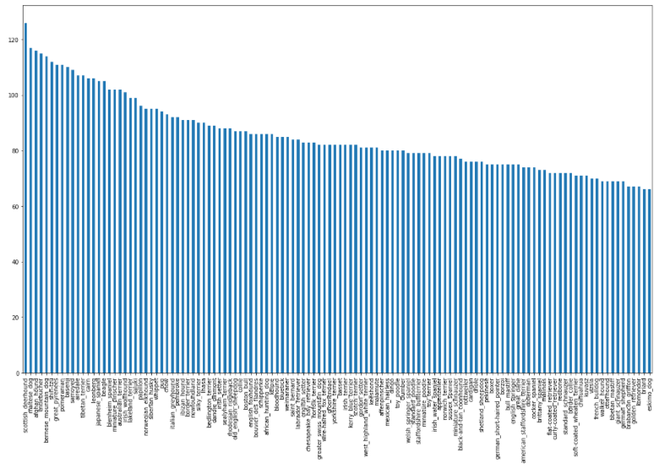
Data
Kaggle
Training data set
10222 Images
id number
120 classes
Median of 82 images per class

Slide 6
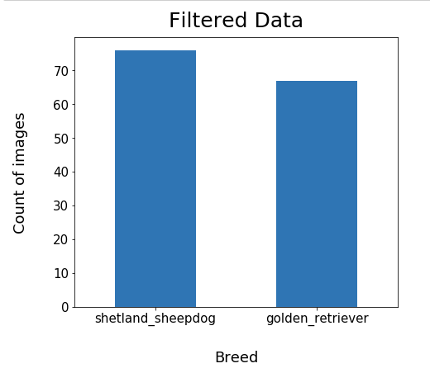
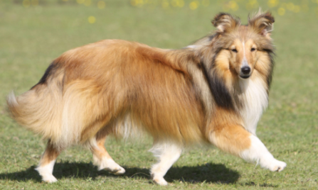
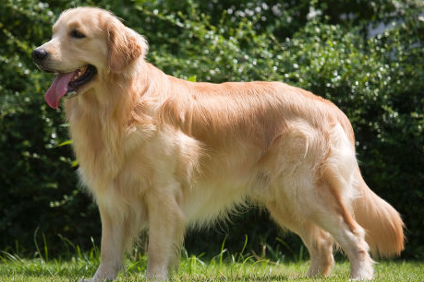
Data Processing
Restricted our model to two majestic breeds – Shetland Sheepdog and Golden Retriever.

Slide 7
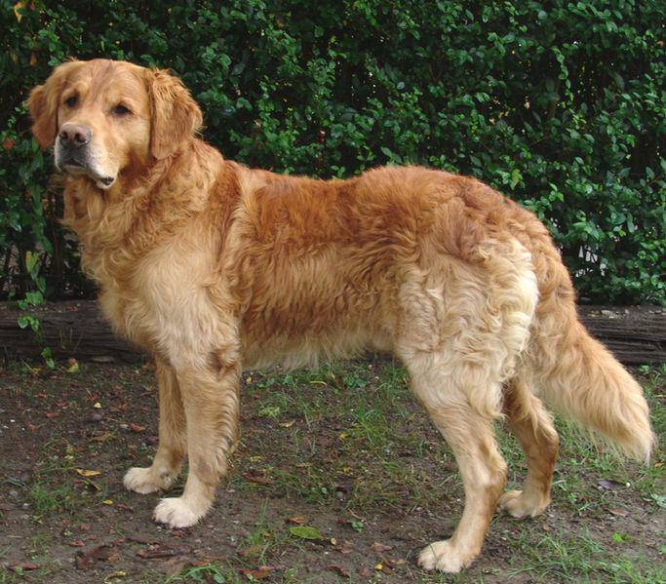
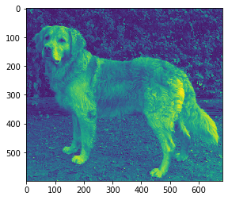
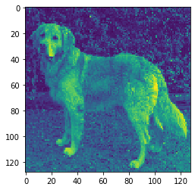
Data Processing
cv2.imread(…, cv2.IMREAD_GRAYSCALE)
cv2.resize(…, (128, 128))

Slide 8
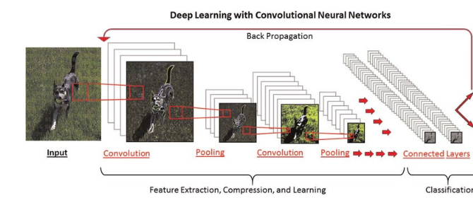
CNN Model Design

Slide 9
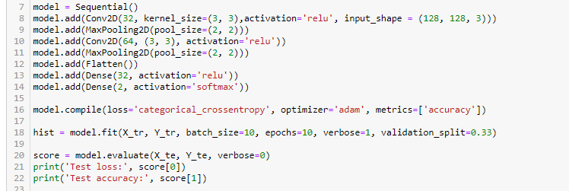
CNN Model Design

Slide 10
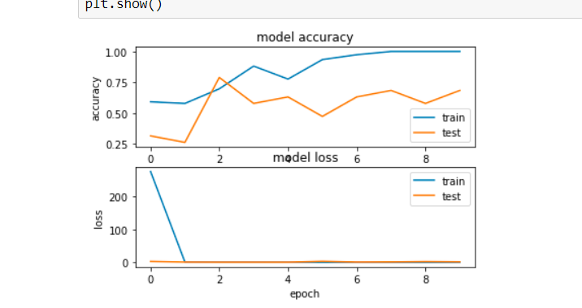
Model execution & learning curve
Testing Accuracy around 0.6
Training Accuracy increase from 0.6 to 1
Model loss drop signicantly after 2 epochs

Slide 11
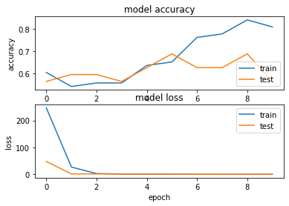
Model Execution – Add Dropout
Dropouts (0.6) were added before and after fully connection.
Accuracy: 0.67
Test accuracy is close to training
accuracy around 4th epoch.

Slide 12

Conclusion
The goal of this project is to create a classifier to identify a dog's breed from a photo. A deep learning and convolutional neural networks have been used for dog breed detection.
After we evaluated our designed model, we consider our results to be a success given the high number of breeds in this fine-grained classification problem. We are able to effectively predict the correct breed with the dataset.
The accuracy of our detection allowed us to succeed with our classification algorithms and is promising for future work in the area.

Slide 13
Limitation
We noticed our convolutional neural network had trouble when more than one dog was featured in an image.
The neural networks are time consuming to train and iterate upon

Slide 14
Future Work
Given the success of our detection network, this is a promising technique for future projects. The neural networks take an enormous time to train and we were unable to perform many iterations on our technique due to time constraints.
We recommend further exploration into neural networks for detection or classification, specifically by training networks with a different architecture and batch iterator to see what approaches might have greater success.

Slide 15
Thank you!
Any questions?

